Slide 1


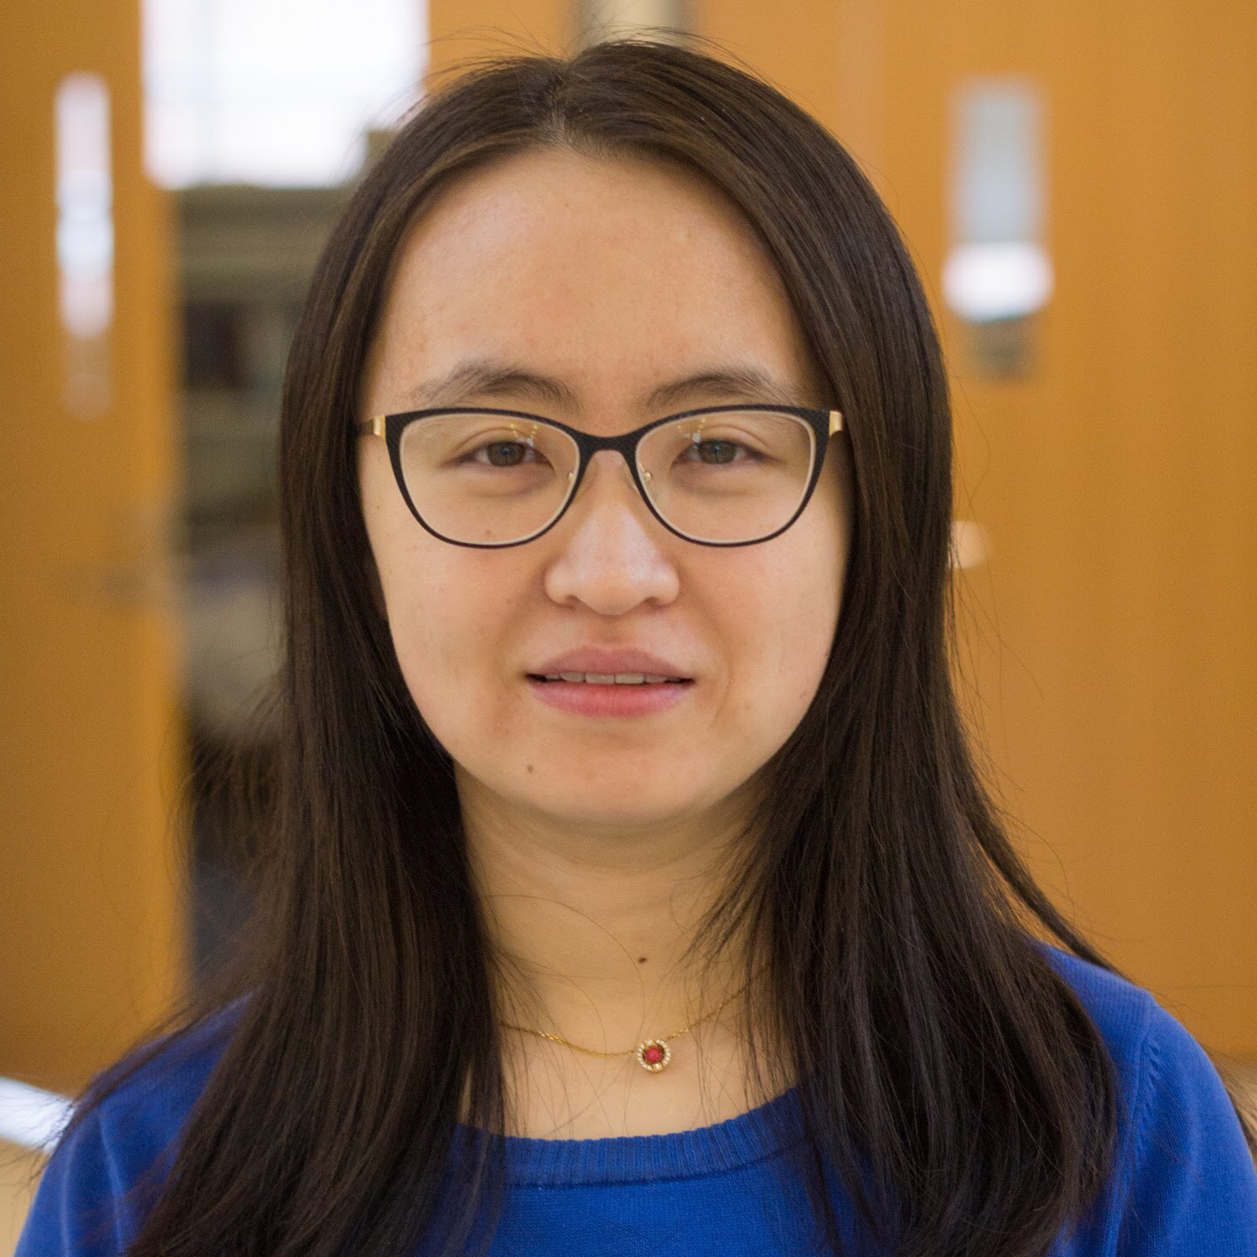
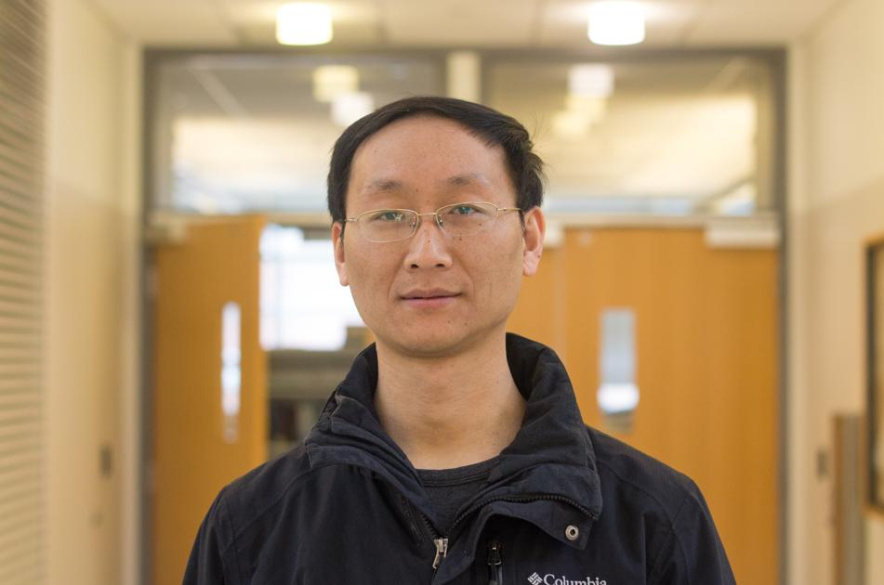

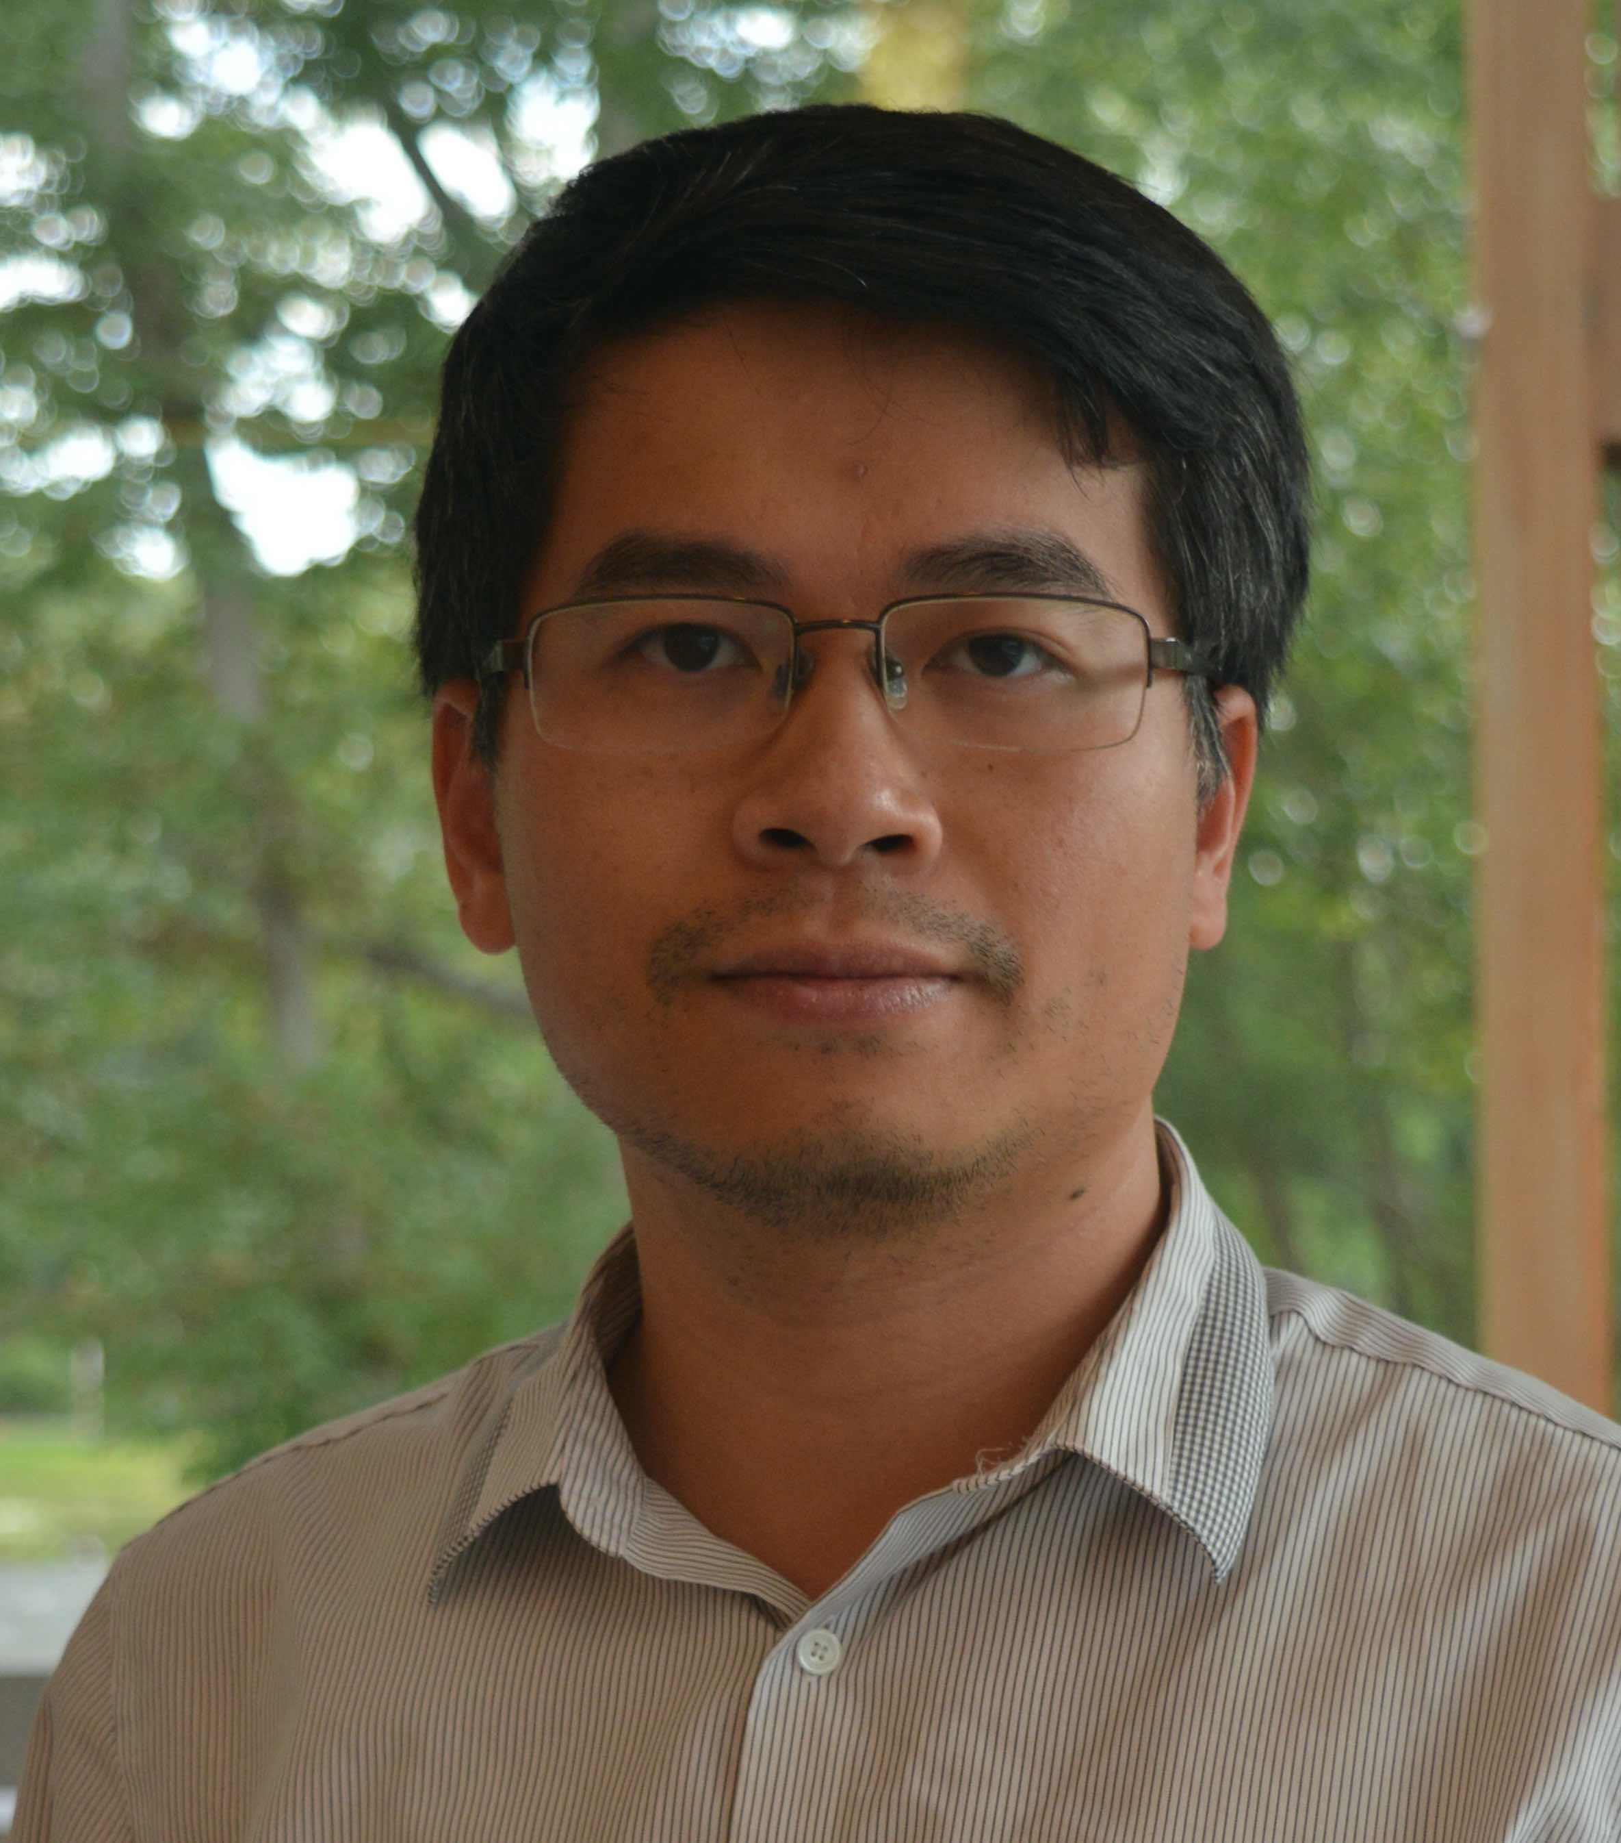
Distribution Matching for Crowd Counting
Boyu Wang*
Huidong Liu*
Dimitris Samaras
Minh Hoai
* Equal Contribution
Notes:
Hello, everyone. This is XXX.
This is YYY. Today we will talk about our work “Distribution matching for crowd counting”. This is a joint work with Dimitris Samaras and Minh Hoai.
In this work, we tackle the task of crowd counting.

Slide 2
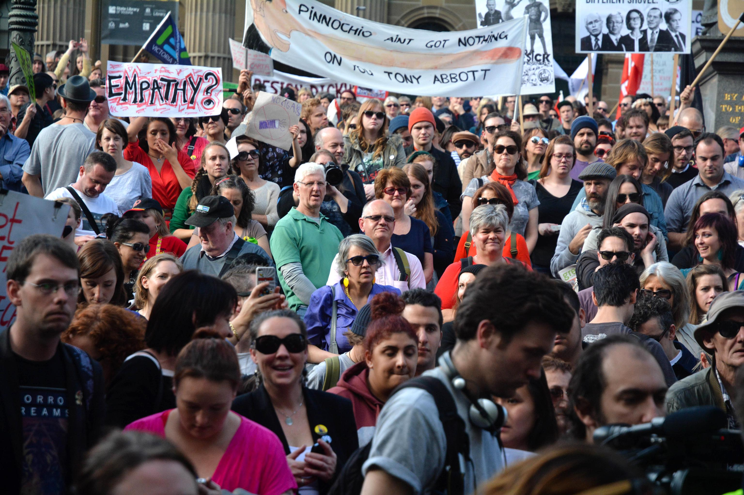
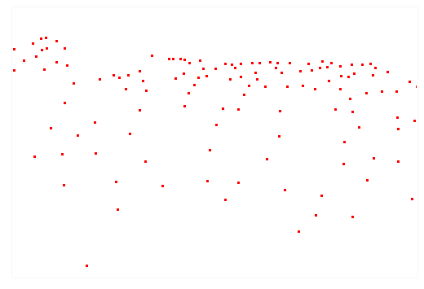
Crowd Counting
118 People
Input Image
Ground Truth Annotation
Notes:
Crowd counting estimates the number of people in an image.
It is an important research problem with various applications in many domains including journalism and surveillance.
It is a challenging task due to huge variations of the crowd densities.
In most datasets, each person is annotated by a single dot on one’s head.

Slide 3
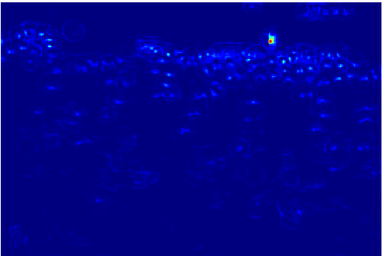
Density Map Estimation
Predicted Density Map
Notes:
State of the art methods treat crowd counting as a density map estimation problem.
The network predicts a 2D crowd density map. The total size of the crowd can be estimated by summing up the density map.

Slide 4
Density Map Estimation
Predicted Density Map
How to measure the discrepancy for training?
Sparse Annotation
Notes:
The prediction map is dense, while the ground truth map is sparse.
During training, how to measure the discrepancy between these two different density maps is important.

Slide 5
Density Map Estimation
Pixel-wise loss on Sparse Annotation does not work well:
Sensitive to dot annotation.
Unbalance between 0s and 1s.
Predicted Density Map
Pixel-wise loss
Sparse Annotation
Notes:
Simply computing the pixel wise loss between the sparse annotation and predicted density map does not work well. The loss is highly sensitive to the exact head location, and heavily unbalanced between 0s and 1s due to the sparsity of the annotation map.

Slide 6
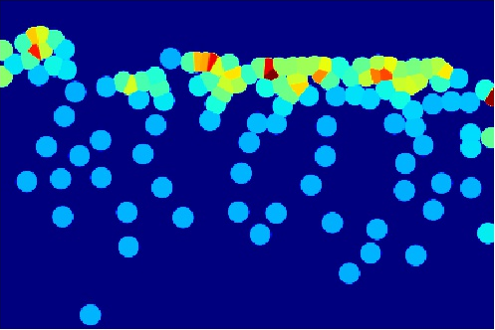
Previous Works
Pixel-wise loss on Gaussian smoothed Ground Truth (GGT)
[1] Zhang et al., Cross-scene crowd counting via deep convolutional neural networks, CVPR 2015.
[2] Zhang et al., Single-image crowd counting via multi-column convolutional neural network, CVPR 2016.
[3] Onoro-Rubio et al., Towards perspective-free object counting with deep learning, ECCV 2016.
[4] Sam et al., Switching convolutional neural network for crowd counting, CVPR 2017.
[5] Li et al., Csrnet: Dilated convolutional neural networks for understanding the highly congested scenes, CVPR 2018.
[6] Ranjan et al., Iterative crowd counting, ECCV 2018.
[7] Cao et al., Scale aggregation network for accurate and efficient crowd counting, ECCV 2018.
[8] Idrees et al., Composition loss for counting, density map estimation and localization in dense crowds, ECCV 2018.
[9] Wang et al., Learning from synthetic data for crowd counting in the wild, CVPR 2019.
[10] Liu et al., Context-aware crowd counting, CVPR 2019.
[11] Shi et al., Revisiting perspective information for efficient crowd counting, CVPR 2019.
[12] Liu et al., Adcrowdnet: An attention- injective deformable convolutional network for crowd understanding, CVPR 2019.
[13] Zhang et al., Relational attention network for crowd counting, ICCV 2019.
[14] Zhang et al., Attentional neural fields for crowd counting, ICCV 2019.
[15] Wan et al., Adaptive density map generation for crowd counting, ICCV 2019.
Predicted Density Map
Pixel-wise loss
Sparse Annotation
Gaussian smoothed Ground Truth (GGT)
Notes:
One approach to alleviate this problem is to turn each annotated dot into a Gaussian blob such that the ground truth is more balanced.
The network is trained to minimize the pixel-wise loss between the dense prediction and the Gaussian smoothed ground truth (GGT).
Almost all previous works have followed this convention.

Slide 7
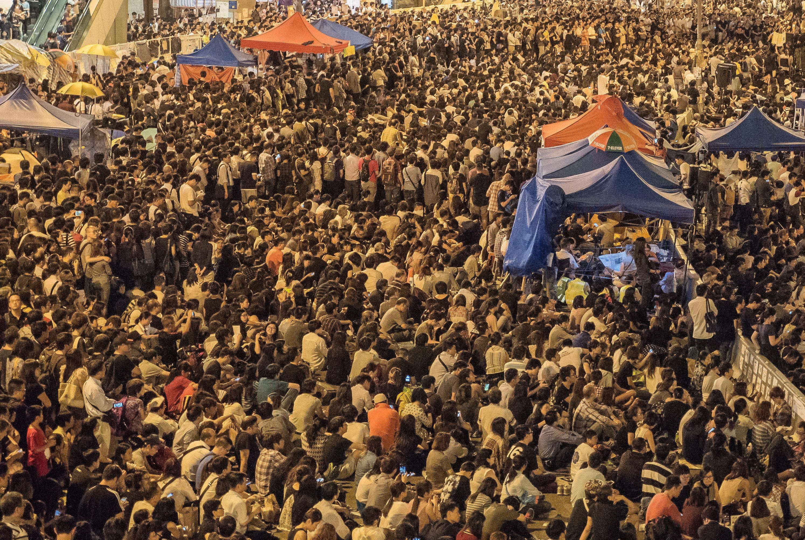

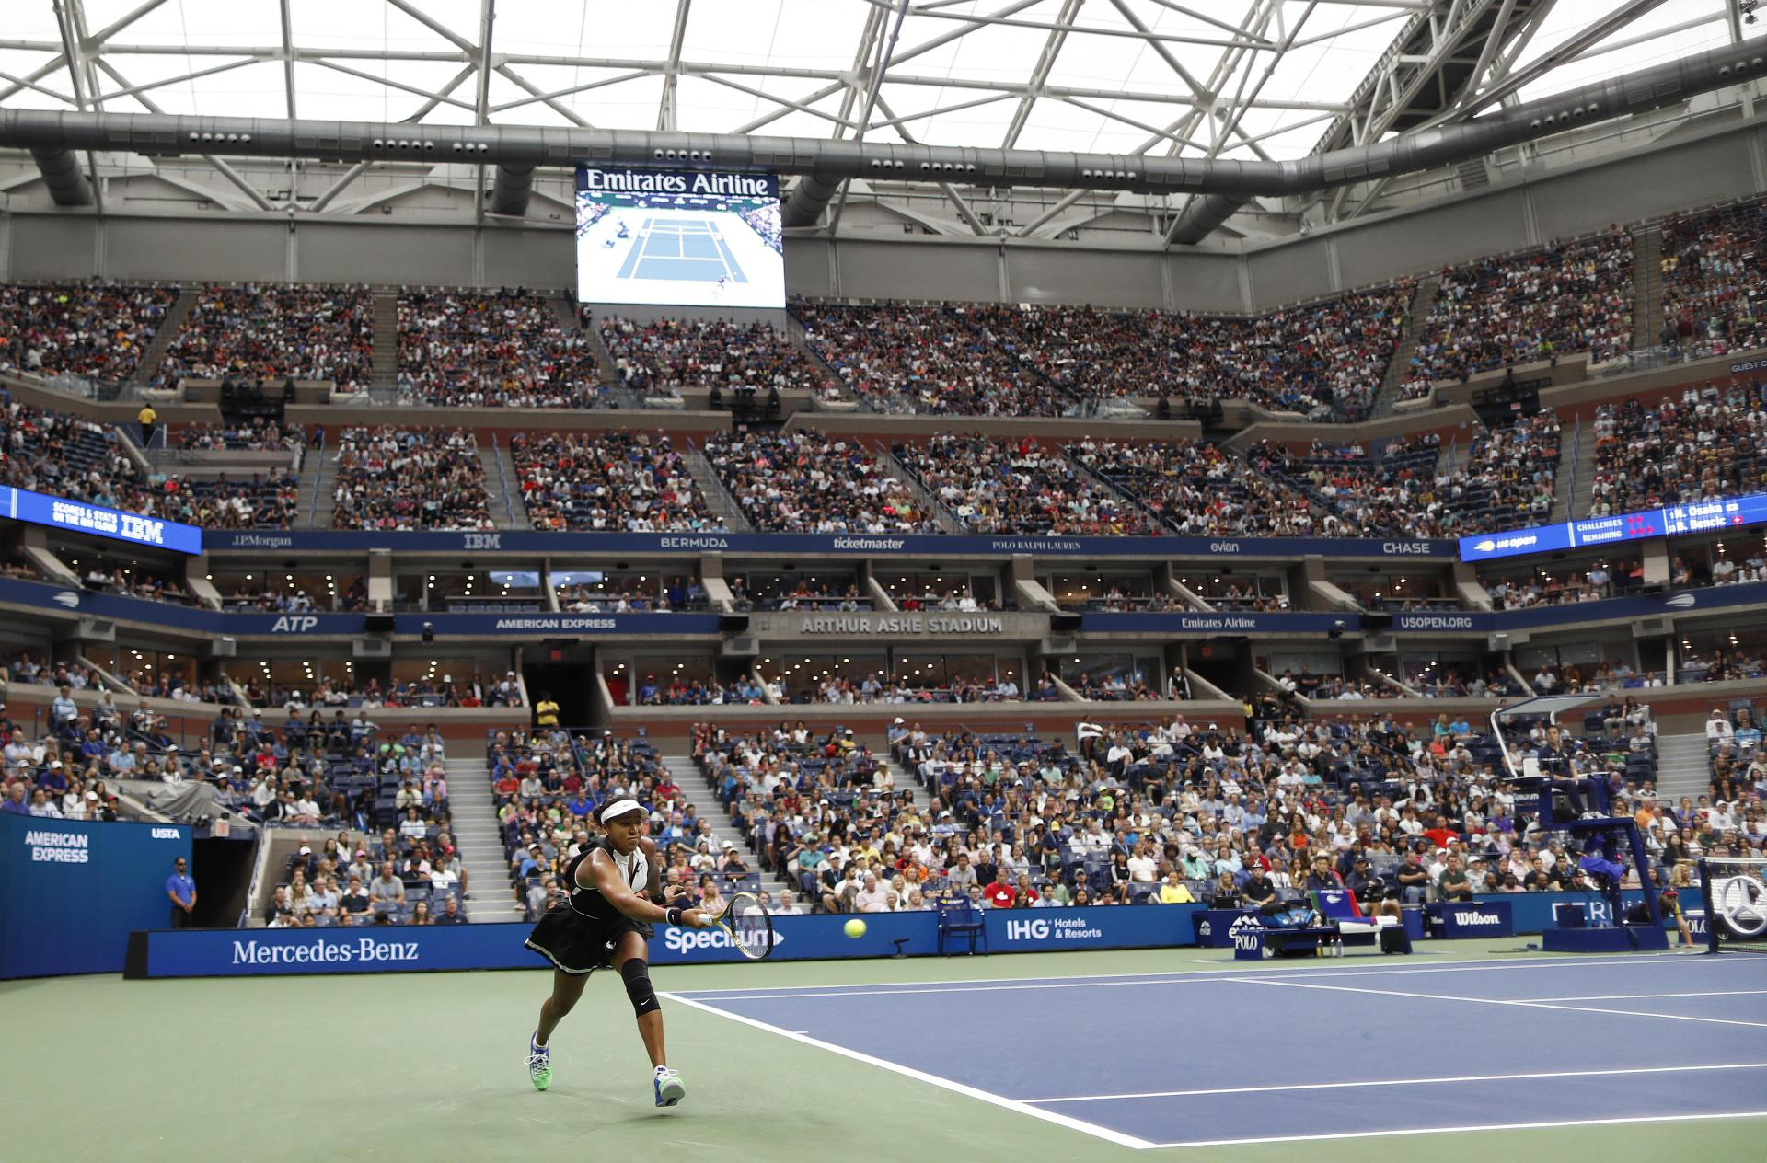
Previous Works
Pixel-wise loss on Gaussian smoothed Ground Truth (GGT)
Gaussian width is difficult to choose:
Huge variations in human size, shape
Irregular crowd distributions
Occlusions
Notes:
Unfortunately, the performance of the resulting network is highly dependent on the quality of the “Gaussian smoothed ground truth”.
However, it’s non trival to set the right widths for the Gaussian blobs due to huge variations in human size and shape, irregular crowd distributions, and occlusions.

Slide 8
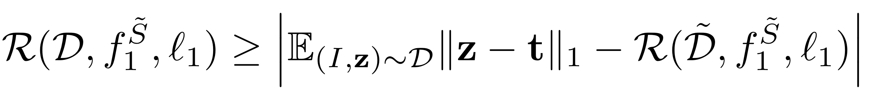
Previous Works
Pixel-wise loss on Gaussian smoothed Ground Truth (GGT)
Gaussian width is difficult to choose.
Imposing Gaussians to annotations hurts the generalization performance.
Generalization Error
Real GT and GGT gap
Empirical Error
Notes:
We prove that imposing Gaussians hurts the generalization performance.
The generalization error is no less than the absolute difference between the real ground truth and Gaussian smoothed ground truth gap and the empirical error.

Slide 9
Previous Works
Pixel-wise loss on Gaussian smoothed Ground Truth (GGT)
Gaussian width is difficult to choose.
Imposing Gaussians to annotations hurts the generalization performance.
Generalization Error
Real GT and GGT gap
Empirical Error
The better a model performs on the Gaussian smoothed ground truth, the poorer it generalizes on real ground truth.
Notes:
That is to say, when the empirical error is small enough, the better a model fits on the Gaussian smoothed ground truth, the poorer it generalizes to the real ground truth.

Slide 10
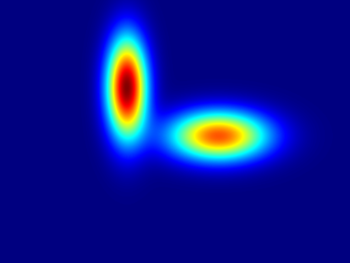
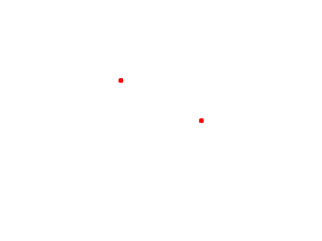
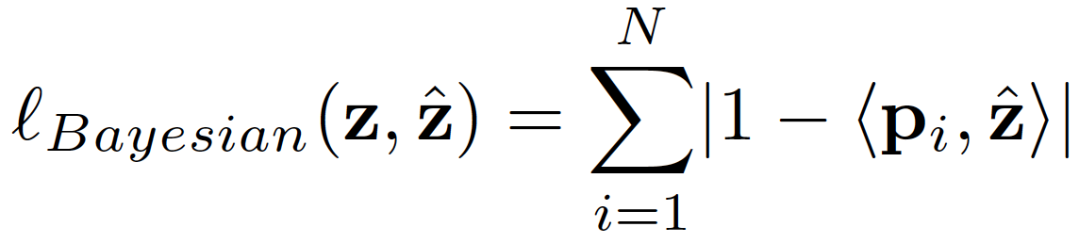
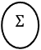
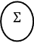

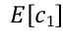
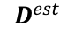
Previous Works
Pixel-wise loss on Gaussian smoothed Ground Truth (GGT)
Gaussian width is difficult to chose.
Imposing Gaussians to annotations hurts the generalization performance.
The Bayesian loss [1]
$$Σ$$
1
$$E\left[c1\right]$$
supervision
1
$$E\left[c2\right]$$
$$Σ$$
$$D^{est}$$
Expectation
Point Annotation
[1] Ma et al., Bayesian loss for crowd count estimation with point supervision, ICCV 2019.
Notes:
Recently, the Bayesian loss was proposed.
This method transforms a binary ground truth annotation map into N “smoothed ground truth” density maps. Here N is the counting number. Each smoothed ground truth density map p i is the posterior probability of all pixels belonging to the i-th annotated dot.

Slide 11

Previous Works
Pixel-wise loss on Gaussian smoothed Ground Truth (GGT)
Gaussian width is difficult to chose.
Imposing Gaussians to annotations hurts the generalization performance.
The Bayesian loss [1]
$$Σ$$
1
$$E\left[c1\right]$$
supervision
1
$$E\left[c2\right]$$
$$Σ$$
$$D^{est}$$
Expectation
Point Annotation
When loss is 0, # of equations is less than # of variables, and thus Bayesian loss is underdetermined.
[1] Ma et al., Bayesian loss for crowd count estimation with point supervision, ICCV 2019.
Notes:
However, when the loss is 0, the number of equations is less than the number of variables, therefore, the Bayesian loss is underdetermined. The predicted density map could be very different from the ground truth density map.

Slide 12
Our Contributions
Propose DM-Count. Use optimal transport to compute the distance between density maps.
Predicted Density Map
Source Distribution
Distribution Distance
Sparse Annotation
Target Distribution
Notes:
In this work, we consider density maps as distributions. Our approach does not need any Gaussian to preprocess ground truth annotations.
We treat the predicted density map as the source distribution and the ground truth annotation as the target distribution.
and use optimal transport to compute the distance between density maps.

Slide 13
Our Contributions
Propose DM-Count. Use optimal transport to compute the distance between density maps.
Provide a tighter generalization bound than pixel-wise loss using Gaussian smoothed GT.
Predicted Density Map
Source Distribution
Distribution Distance
Sparse Annotation
Target Distribution
Notes:
We present the generalization error bound of our method. The bounds are tighter than those of the pixel-wise loss using Gaussian smoothed ground truth.

Slide 14
Our Contributions
Propose DM-Count. Use optimal transport to compute the distance between density maps.
Provide a tighter generalization bound than pixel-wise loss using Gaussian smoothed GT.
Achieve SOTA results on crowd counting datasets. Reduced MAE on NWPU from 105 to 88.
Predicted Density Map
Source Distribution
Distribution Distance
Sparse Annotation
Target Distribution
Notes:
We show state-of-the-art results on crowd counting datasets. Notably, We reduced the mean absolute error on the NWPU dataset from 105 to 88. Noteably, we reduced the mean absolute error on the NWPU dataset by 17%.

Slide 15
Distribution Matching for Crowd Counting (DM-Count)
Losses
The Counting loss
Source Distribution
Target Distribution
Notes:
Our proposed method has three components.
The first is counting loss, which measure the difference between predicted count and ground truth count.

Slide 16
Distribution Matching for Crowd Counting (DM-Count)
Losses
The Counting loss
The Optimal Transport (OT) loss
Optimal Transport (OT)
Notes:
The second loss is Optimal Transport loss.
Optimal transport is a principled way to measure the distance between distributions.

Slide 17
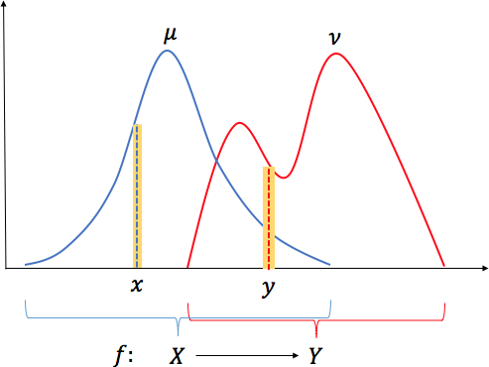
Distribution Matching for Crowd Counting (DM-Count)
Losses
The Counting loss
The Optimal Transport (OT) loss
Optimal Transport (OT)
Notes:
Here’s an illustration. Every point x in the source distribution mu will be moved to y in the target distribution nu, and the probability measure in the local neighborhood of x is equal to that of y. For example, the area of the left yellow bin is equal to the right yellow bin.

Slide 18
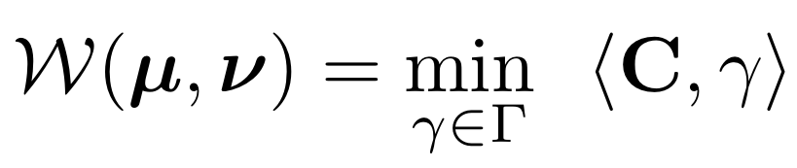
Distribution Matching for Crowd Counting (DM-Count)
Losses
The Counting loss
The Optimal Transport (OT) loss
Optimal Transport (OT)
Primal form:
where
Notes:
The objective of OT is to minimize the total moving cost, which is expressed in the primal form here. In this form, C is the transport cost matrix. Capital gamma is the set of all joint distributions whose marginals are mu and nu, respectively. Gamma indicates how much "mass" should be transported from x to y such that mu is transformed to nu.

Slide 19
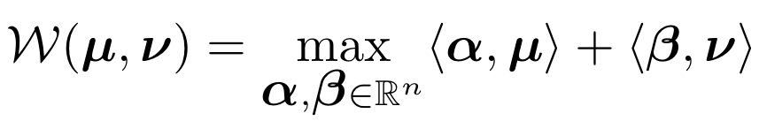
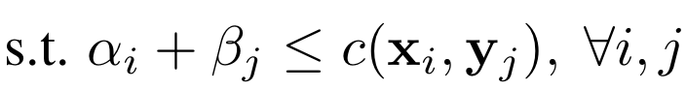
Distribution Matching for Crowd Counting (DM-Count)
Losses
The Counting loss
The Optimal Transport (OT) loss
Optimal Transport
Primal form:
where
Dual form:
Notes:
The dual form of OT is expressed below, where c(xi, yj) is the cost function between xi and yj, alpha and beta are dual variables.

Slide 20
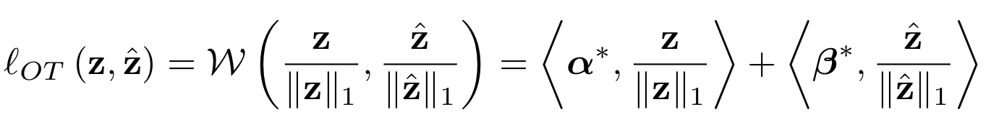
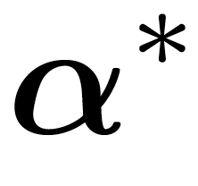
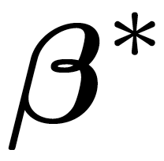
Distribution Matching for Crowd Counting (DM-Count)
Losses
The Counting loss
The Optimal Transport (OT) loss
Source Distribution
where and are solutions of the optimal transport problem:
Dual form:
Target Distribution
Notes:
We use the dual form of OT in DM-Count, because the distributions are in the objective of the dual form and the objective can provide the gradient for the source distribution to update the network.
As the total mass of the predicted density map and ground truth density map are different, we first normalize both density maps, and then use the dual form of OT to compute the distance between these two normalized density maps.
Alpha star and beta star are solutions of the dual form. In our experiments, we use the Sinkhorn algorithm to approximate alpha star and beta star.

Slide 21
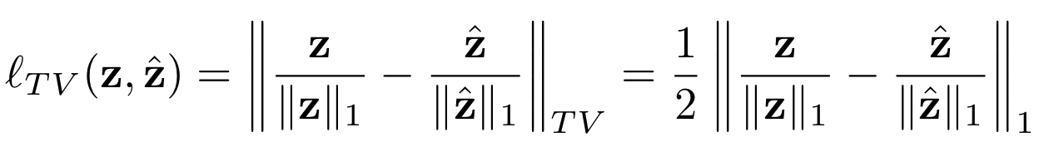
Distribution Matching for Crowd Counting (DM-Count)
Losses
The Counting loss
The Optimal Transport (OT) loss
The Total Variation (TV) loss
Stabilize OT computation
Source Distribution
Target Distribution
Notes:
As the convergence of Sinkhorn algorithm is slow, to stabilize OT computation, we include the Total Variation loss.
Total variation loss is equivalent to half of the the l1 distance between two normalized density maps.

Slide 22
Distribution Matching for Crowd Counting (DM-Count)
Losses
The Counting loss
The Optimal Transport (OT) loss
The Total Variation (TV) loss
The overall objective
Source Distribution
Target Distribution
Notes:
The overall objective is the combination of these three losses.
where λ1 and λ2 are tunable hyper-parameters for the OT loss and the TV loss, respectively.

Slide 23
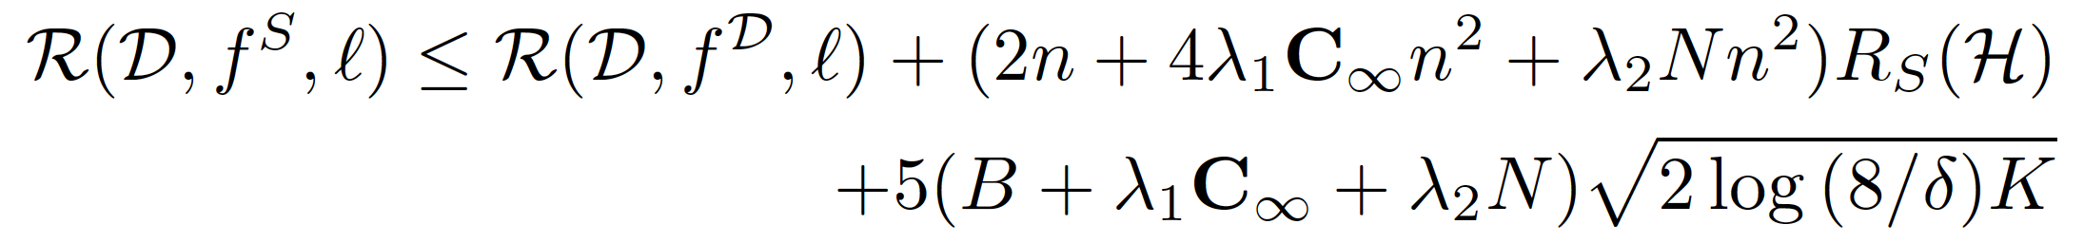
Distribution Matching for Crowd Counting (DM-Count)
Generalization bound of DM-Count
Source Distribution
Expected risk using an empirical minimizer
Expected risk using the optimal minimizer
As # of data K increases, the expected risk using an empirical minimizer converges to the expected risk using the optimal minimizer.
Target Distribution
Notes:
We show the generalization bound of DM-Count. As the number of data K increases, the expected risk using an empirical minimizer converges to the expected risk using the optimal minimizer.

Slide 24
Distribution Matching for Crowd Counting (DM-Count)
Generalization bound of DM-Count
Source Distribution
Expected risk using an empirical minimizer
Expected risk using the optimal minimizer
As # of data K increases, the expected risk using an empirical minimizer converges to the expected risk using the optimal minimizer.
Target Distribution
Generalization bound of Pixel-wise loss using GGT
Positive constant.
Notes:
This bound is tighter than the generalization bound of the Pixel-wise loss using Gaussian smoothed ground truth, because the generalization bound of the pixel-wise loss has a positive constant term, which is the real ground truth and Gaussian smoothed ground truth gap, that prevents its convergence.

Slide 25
Experimental results
17 %
number of Images
5109
Notes:
We evaluated our method on four challenging datasets.
On the largest dataset NWPU, our method reduced the mean absolute error by 17 percent, from 105 to 88.

Slide 26
Experimental results
17 %
number of Images
5109
1535
482
716
Notes:
Here are results on all datasets. It is worth noting that our method achieved state of the art performance using a simple VGG backbone.

Slide 27
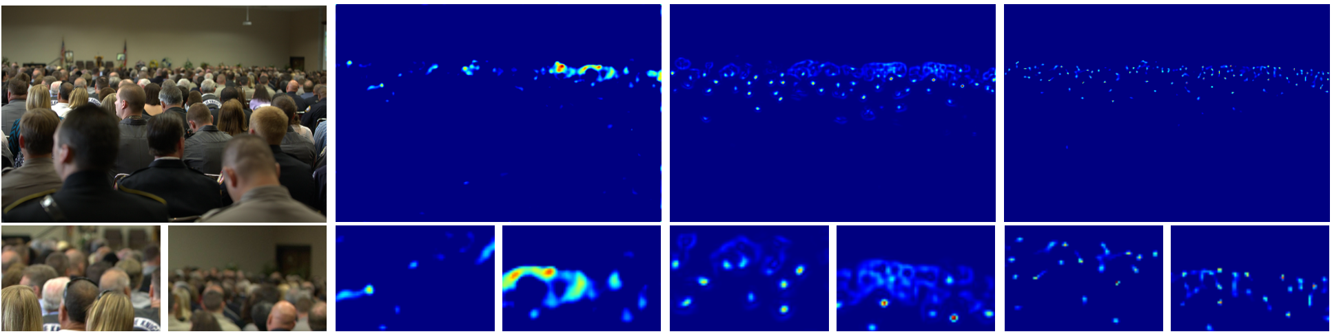
Visualization
Input Image
Pixel-wise loss
Bayesian loss
DM-Count (ours)
Ground Truth Count: 139
Count: 83.2
Count: 98.3
Count: 137.6
Notes:
Here we visualize the predicted density maps from different methods. DM-Count is able to produce a more accurate count.

Slide 28
Visualization
Input Image
Pixel-wise loss
Bayesian loss
DM-Count (ours)
Ground Truth Count: 139
Count: 83.2
Count: 98.3
Count: 137.6
PSNR: 43
PSNR: 39
PSNR: 45
SSIM: 0.83
SSIM: 0.75
SSIM: 0.86
Notes:
A closer look showed that density maps generated by DM-count is much sharper, which results in higher Peak Signal-to-Noise Ratio (PSNR) and Structural Similarity (SSIM).

Slide 29
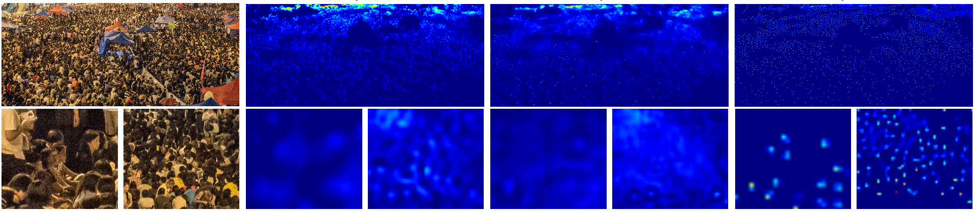
Visualization
Input Image
Pixel-wise loss
Bayesian loss
DM-Count (ours)
Ground Truth Count: 2638
Count: 1755.7
Count: 2236.3
Count: 2656.7
PSNR: 31
PSNR: 30
PSNR: 37
SSIM: 0.12
SSIM: 0.08
SSIM: 0.26
Notes:
Here is another example. DM count produces both accurate and sharp density maps.

Slide 30
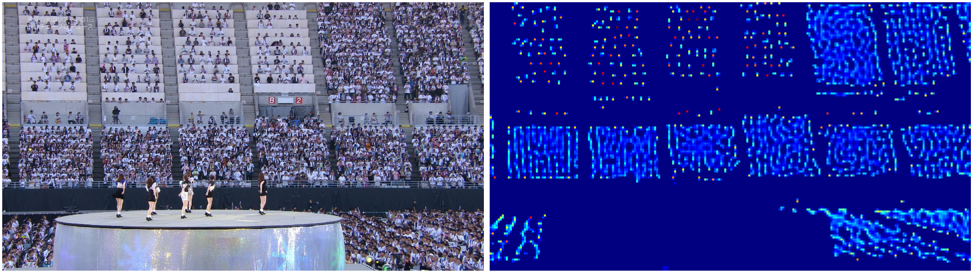
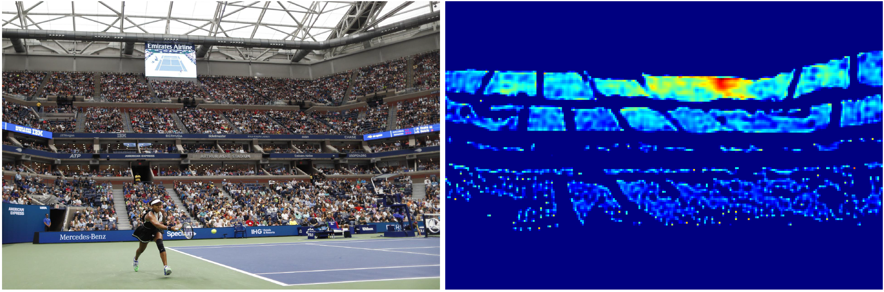
Visualization
GT count: 1748
GT count: 3470
Notes:
We visualize additional results by DM-Count on very dense crowd images.

Slide 31
Visualization
GT count: 1748
DM-Count: 1634.4
GT count: 3470
DM-Count: 3116.1
Notes:
DM-Count works well on these images in terms of density map visualization and counting number.

Slide 32
Ablation studies
Notes:
The loss in DM-Count is composed of three parts, the counting loss, the OT loss and the TV loss.
We study the contribution of each component. As shown in the figure, all three losses are essential to final performance.
However, the OT loss is the most important component.

Slide 33
Ablation studies
Notes:
Here, we investigate the effect of number of Sinkhorn iterations in DM-Count.
using a small number of iterations lowers the performance, which indicates that we obtain inaccurate OT solutions.
When the number of iterations is greater than 100, DM-Count performance is state of the art and stable.

Slide 34
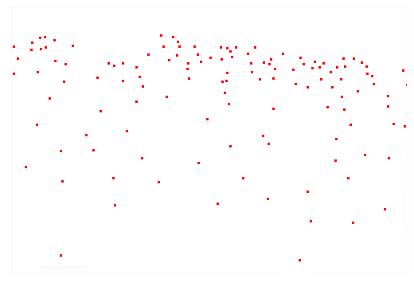
Ablation studies
Add noise
Input Image
Ground Truth Annotation
Noisy Annotation
Notes:
Crowd annotation is performed by placing a single dot on a person. Such process is ambiguous and could lead to inevitable annotation errors.
We study how different loss functions perform w.r.t. annotation errors.
We add random noise to the original annotation and train different models with the same noisy annotation.

Slide 35
Ablation studies
Notes:
The proposed DM-Count is more robust to annotation errors compared to the pixel-wise and Bayesian losses.

Slide 36
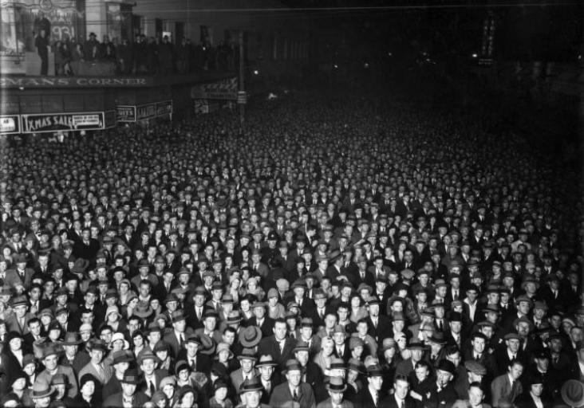
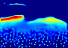
Failure cases
GT count: 1443
DM-Count: 678.6
Notes:
Here we visualize two failure cases by DM-Count. These images either have poor illumination

Slide 37
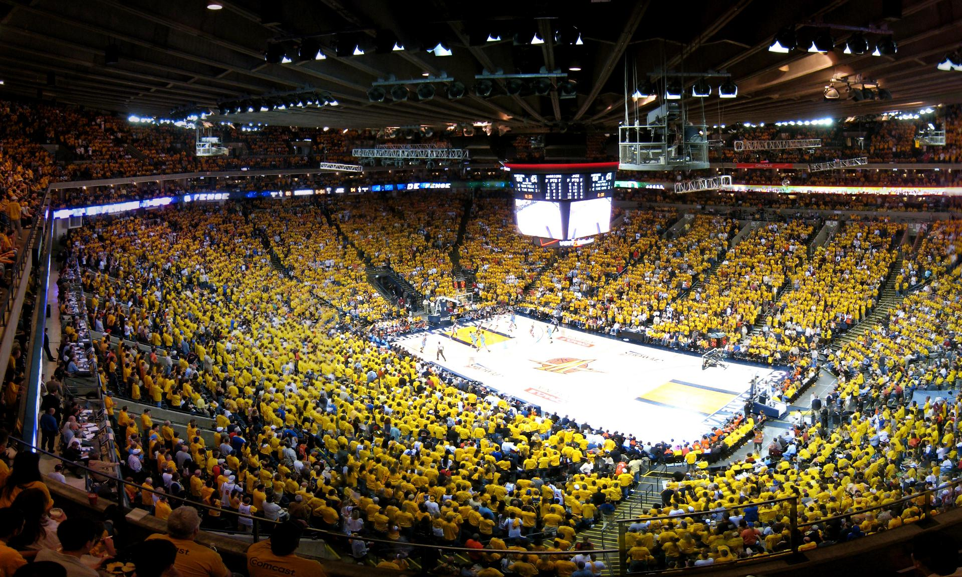
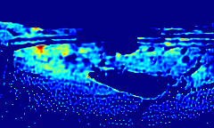
Failure cases
GT count: 1443
DM-Count: 678.6
GT count: 7122
DM-Count: 4860
Notes:
or extremely dense crowds, that are hard even for human observers.

Slide 38
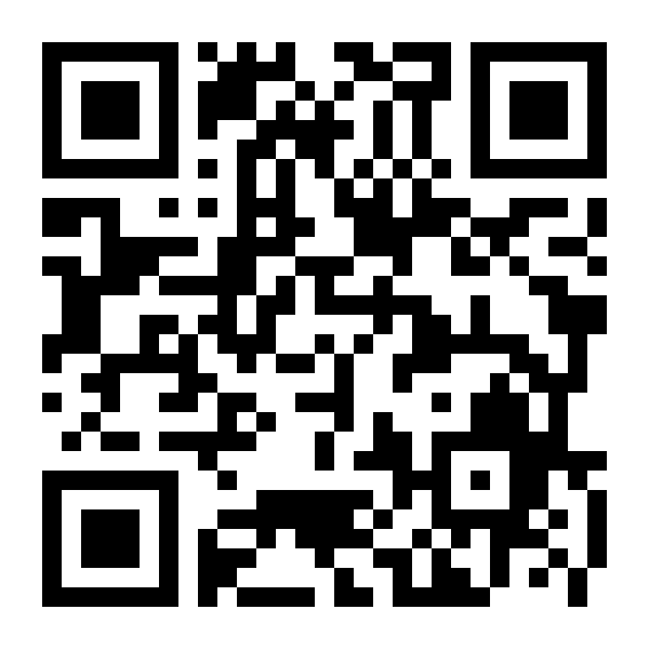
Takeaways
Imposing Gaussians to dot annotations hurts the generalization performance of the crowd count network.
Code and Pre-trained models are at
https://github.com/cvlab-stonybrook/DM-Count
Notes:
In summary, first we prove that imposing Gaussians to annotations hurts the generalization performance.

Slide 39
Takeaways
Imposing Gaussians to dot annotations hurts the generalization performance of the crowd count network.
We propose DM-Count, in which optimal transport is used to measure the distance between predicted density maps and ground truth annotations.
Code and Pre-trained models are at
https://github.com/cvlab-stonybrook/DM-Count
Notes:
Second, we propose DM-Count, which use optimal transport to measure the distance between predicted density maps and ground truth annotations.
Theoretically, it has a tighter generalization bound. Empirically, it outperforms other methods by a large margin.
Thank you for listening! The code and pre-trained models are available here.

